Slide 1
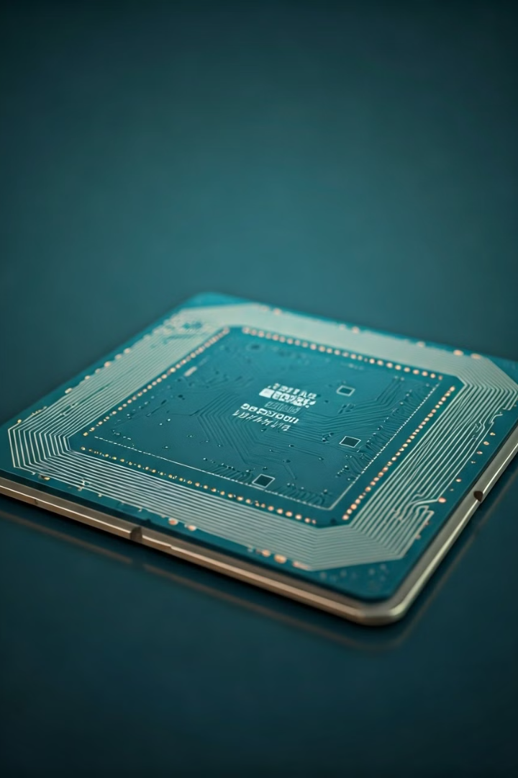


Introduction to Design for Manufacturability (DFM)
Design for Manufacturability (DFM) is a critical aspect of VLSI design that focuses on ensuring a product can be efficiently and cost-effectively manufactured. DFM considers design constraints, process limitations, and yield optimization to create a design that is optimized for the manufacturing process.
by Wai-Shing Luk

Slide 2

Importance of DFM in VLSI design
1
Improved Yield
DFM helps identify and mitigate manufacturing defects, leading to higher product yields and reduced scrap.
2
Cost Optimization
Incorporating DFM early in the design process can significantly reduce manufacturing costs and time-to-market.
3
Design Robustness
DFM principles enhance the design's tolerance to process variations, improving overall reliability and performance.

Slide 3
Key DFM Considerations in VLSI
Design Rules
Process Constraints
Electrical Considerations
Adherence to strict design rules that account for manufacturing limitations, such as minimum feature sizes and spacing requirements.
Understanding the capabilities and limitations of the manufacturing process, including lithography, etching, and deposition techniques.
Ensuring electrical characteristics, such as resistance, capacitance, and signal integrity, are optimized for the manufacturing process.

Slide 4

Design Rules and Process Constraints
Design-Technology Co-Optimization
Design Rules
Establishing a set of design rules that account for the manufacturing process, such as minimum feature sizes, spacing, and aspect ratios.
Iteratively refining the design and manufacturing process to achieve the optimal balance between performance, cost, and yield.
1
2
3
Process Simulation
Utilizing process simulation tools to model and analyze the impact of manufacturing steps on the design, including lithography, etching, and thin-film deposition.

Slide 5

Layout Optimization for Manufacturability
Density and Uniformity
Placement and Routing
Ensuring uniform feature density across the chip to minimize process variations and improve yield.
Optimizing the placement and routing of circuit elements to reduce design complexity and manufacturing constraints.
Dummy Structures
Redundancy and Interconnect
Strategically placing dummy structures to maintain consistent surface topography and improve chemical-mechanical polishing (CMP) performance.
Incorporating redundant structures and optimizing interconnect designs to enhance reliability and yield.

Slide 6





Yield Enhancement Techniques
Defect Mitigation
Identifying and addressing potential sources of manufacturing defects, such as mask defects, process variations, and particle contamination.
Process Monitoring
Implementing robust in-line testing and metrology techniques to quickly detect and address process excursions.
Redundancy
Incorporating redundant circuit elements and interconnects to improve fault tolerance and yield.
Design Optimization
Continuously refining the design and manufacturing process to optimize for yield, performance, and cost.

Slide 7




DFM Analysis and Verification
Design Rule Checking
Verifying that the design adheres to the established manufacturing design rules.
Process Simulation
Simulating the manufacturing process to identify potential defects and yield limitations.
Layout Optimization
Iteratively refining the layout to improve manufacturability and yield.

Slide 8

Conclusion and Best Practices
1
Early DFM Integration
Incorporate DFM considerations early in the design process to maximize the impact and reduce costly redesigns.
2
Collaborative Approach
Foster close collaboration between design and manufacturing teams to ensure a seamless DFM implementation.
3
Continuous Improvement
Regularly review and update DFM strategies to keep pace with evolving manufacturing capabilities and design complexities.

